Slide 1
The ABC of Generative AI
Mayur Madnani
July 2025

Slide 2

Who am I?
Worked with technology giants such as SAP, Walmart, Intuit, and JioHotstar
Technology expert in Software, Data and AI
Published research and patent
Industry mentor
Instructor for Azure Generative Vision AI course: bit.ly/genai-vision
LinkedIn: linkedin.com/in/mayurmadnani/

Slide 3
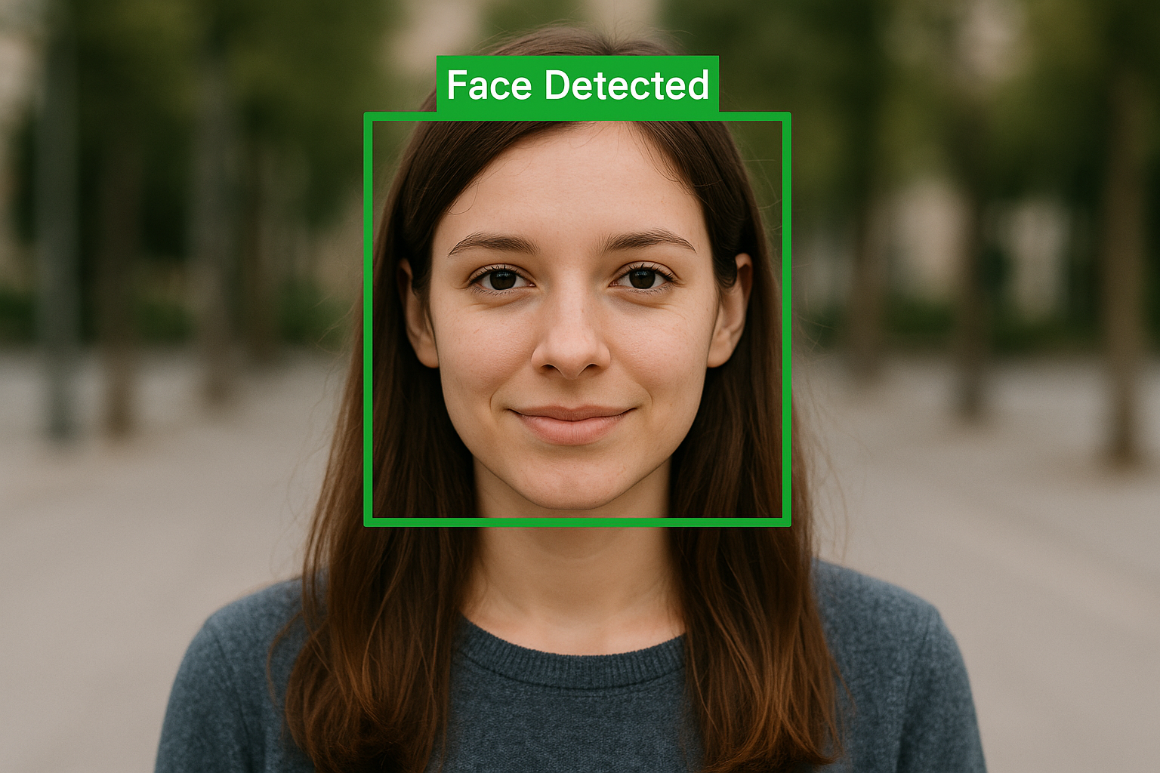
The Face Detection Case Study

Slide 4
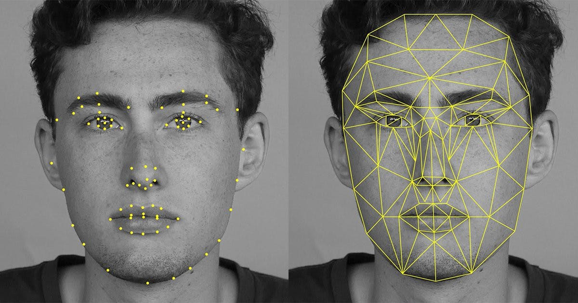
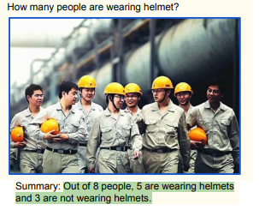
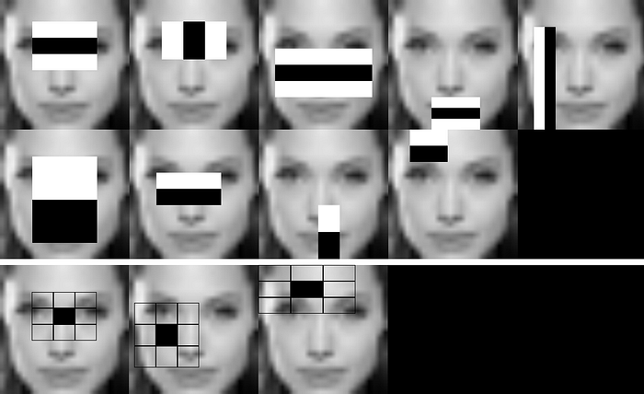
Evolution- Face Detection
Deep Learning
Generative AI
Computer Vision

Slide 5
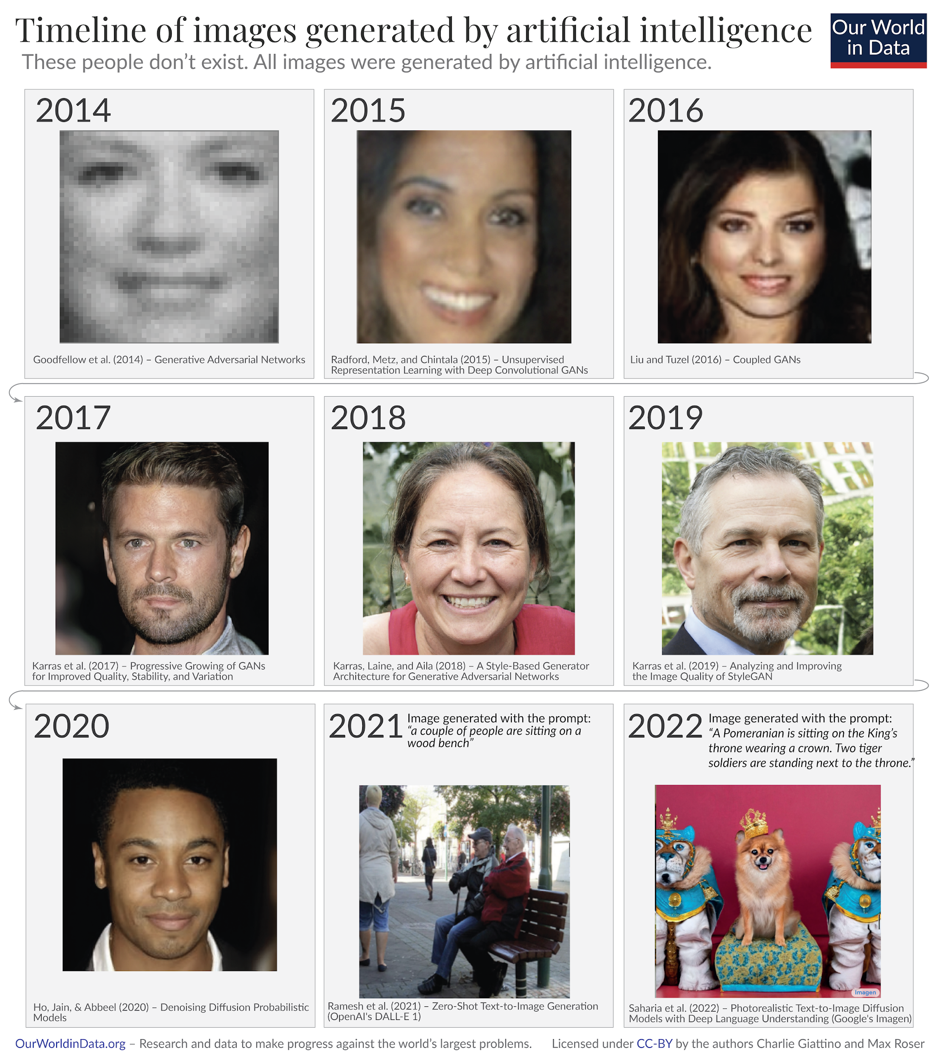
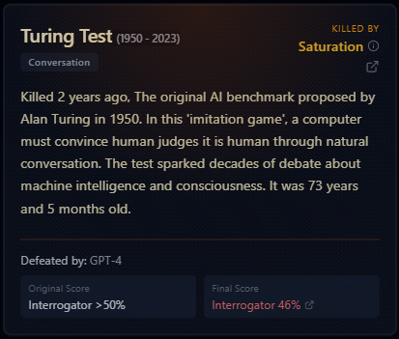
Enter Generative AI
https://ourworldindata.org/brief-history-of-ai
https://r0bk.github.io/killedbyllm/

Slide 6
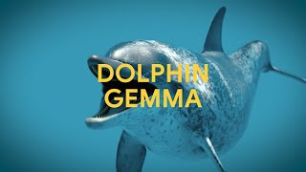

Slide 7
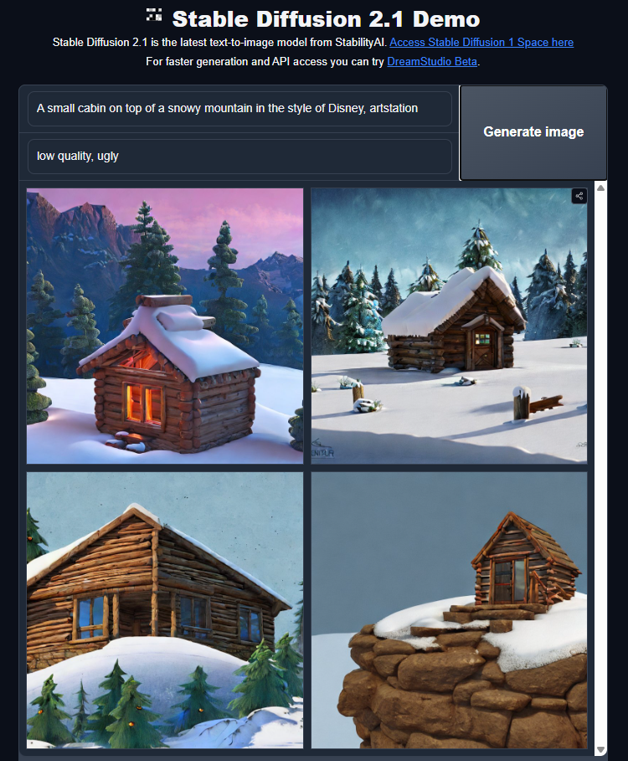
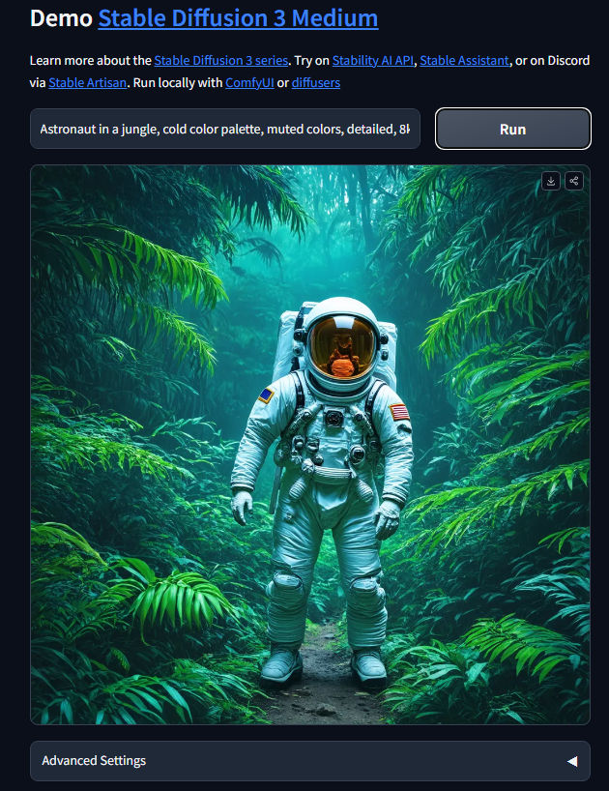
https://huggingface.co/spaces/stabilityai/stable-diffusion
https://huggingface.co/spaces/stabilityai/stable-diffusion-3-medium

Slide 8
What kind of input does Stable Diffusion require to generate an image?
Text prompt
Image sketch
Voice input
Tabular data

Slide 9
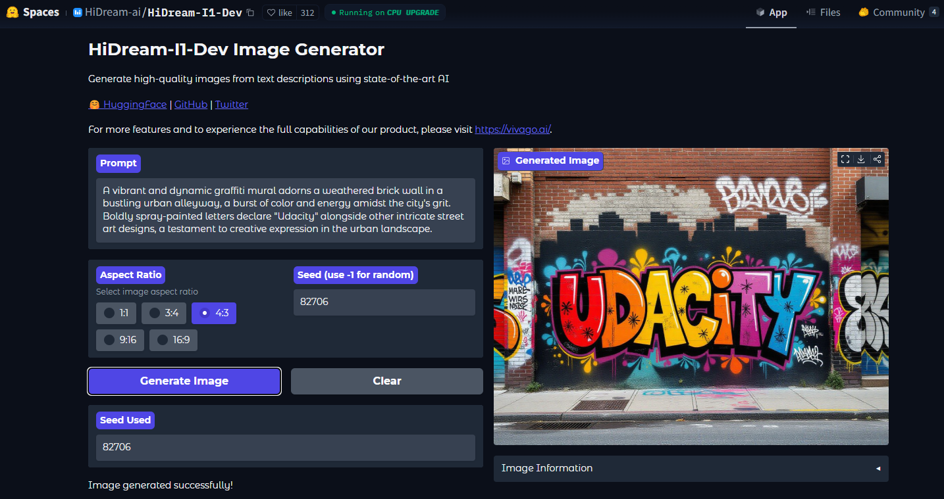
https://huggingface.co/spaces/HiDream-ai/HiDream-I1-Dev

Slide 10
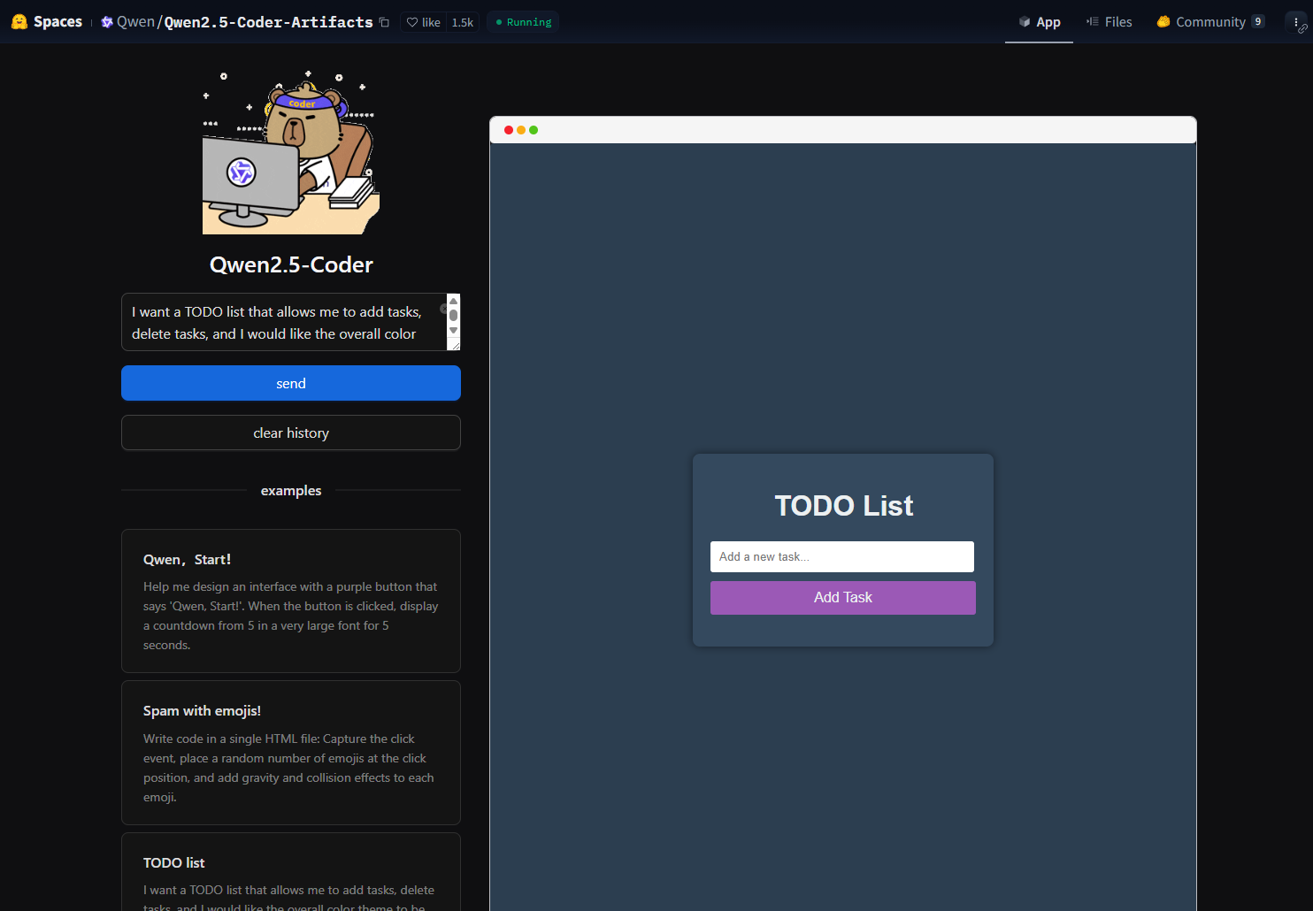
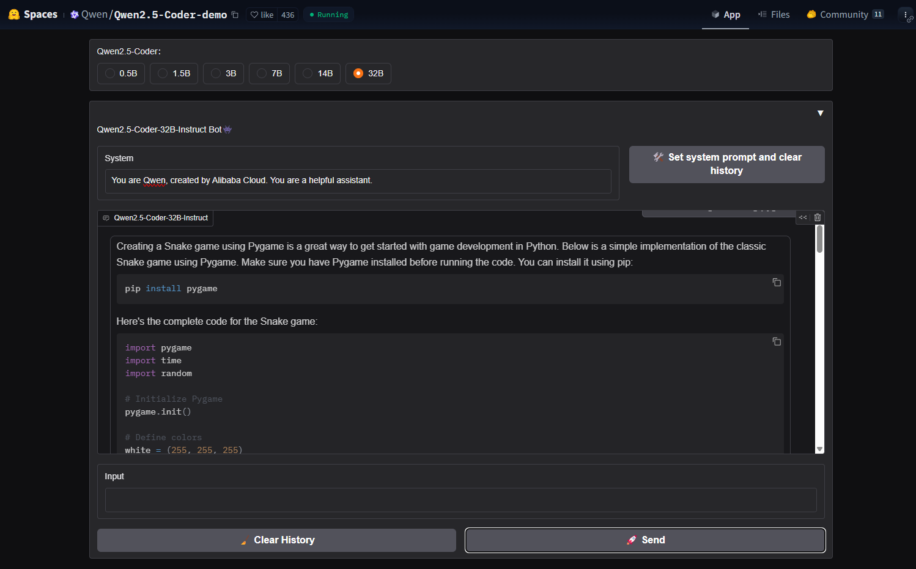
https://huggingface.co/spaces/Qwen/Qwen2.5-Coder-Artifacts
https://huggingface.co/spaces/Qwen/Qwen2.5-Coder-demo

Slide 11

https://huggingface.co/spaces/enzostvs/deepsite

Slide 12
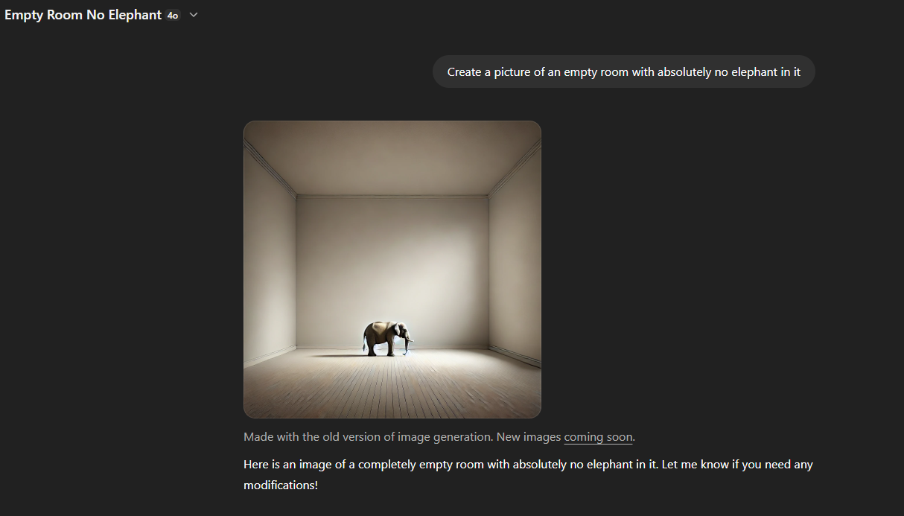
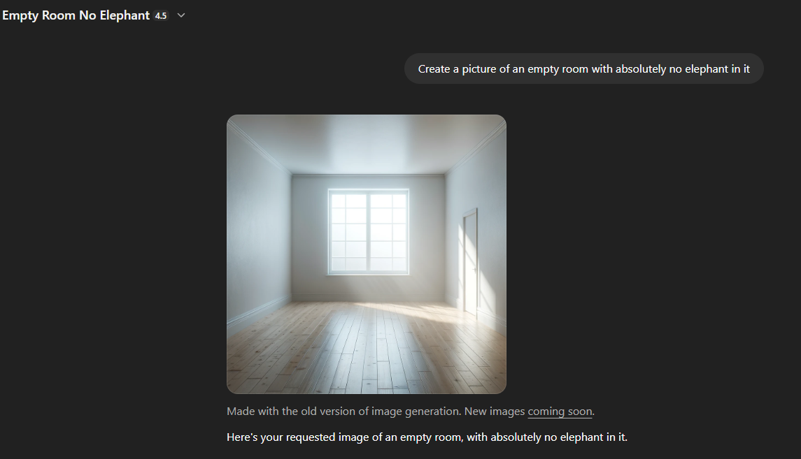
Limitations

Slide 13
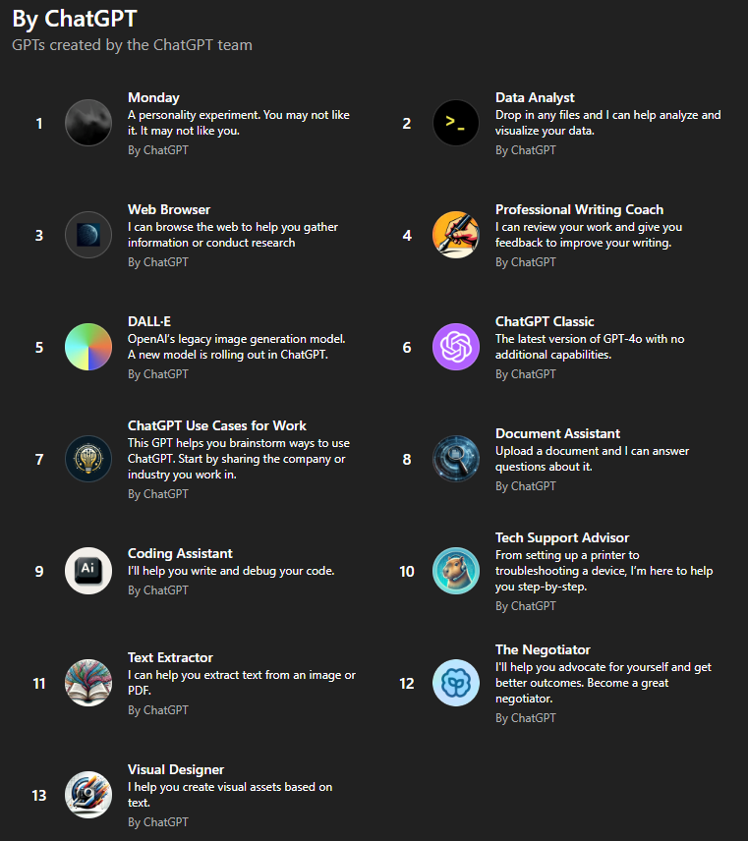
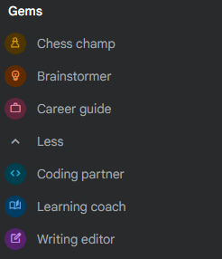
Agents
OpenAI
Gemini

Slide 14
Which of the following is the best example of an autonomous AI agent?
A chatbot that answers FAQs
A model that writes essays from prompts
A system that plans a trip and books flights based on preferences
A text classifier

Slide 15
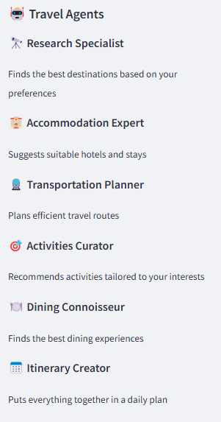
https://huggingface.co/spaces/openfree/AgentX-Travel

Slide 16
Thank you

